Slide 1
Peer Networks
A fun way to hang out with new and old friends!

Slide 2
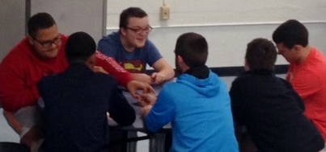
What is a Peer Network?
A peer network is a group of peers (usually four to seven) that meets once a week to socialize and do fun things together.
Peer networks help students get to know each other better and be more connected to everyday school life.
Network members try to see each other throughout the week, even if just to say hi, hang out before the bell rings, or walk to classes together.

Slide 3
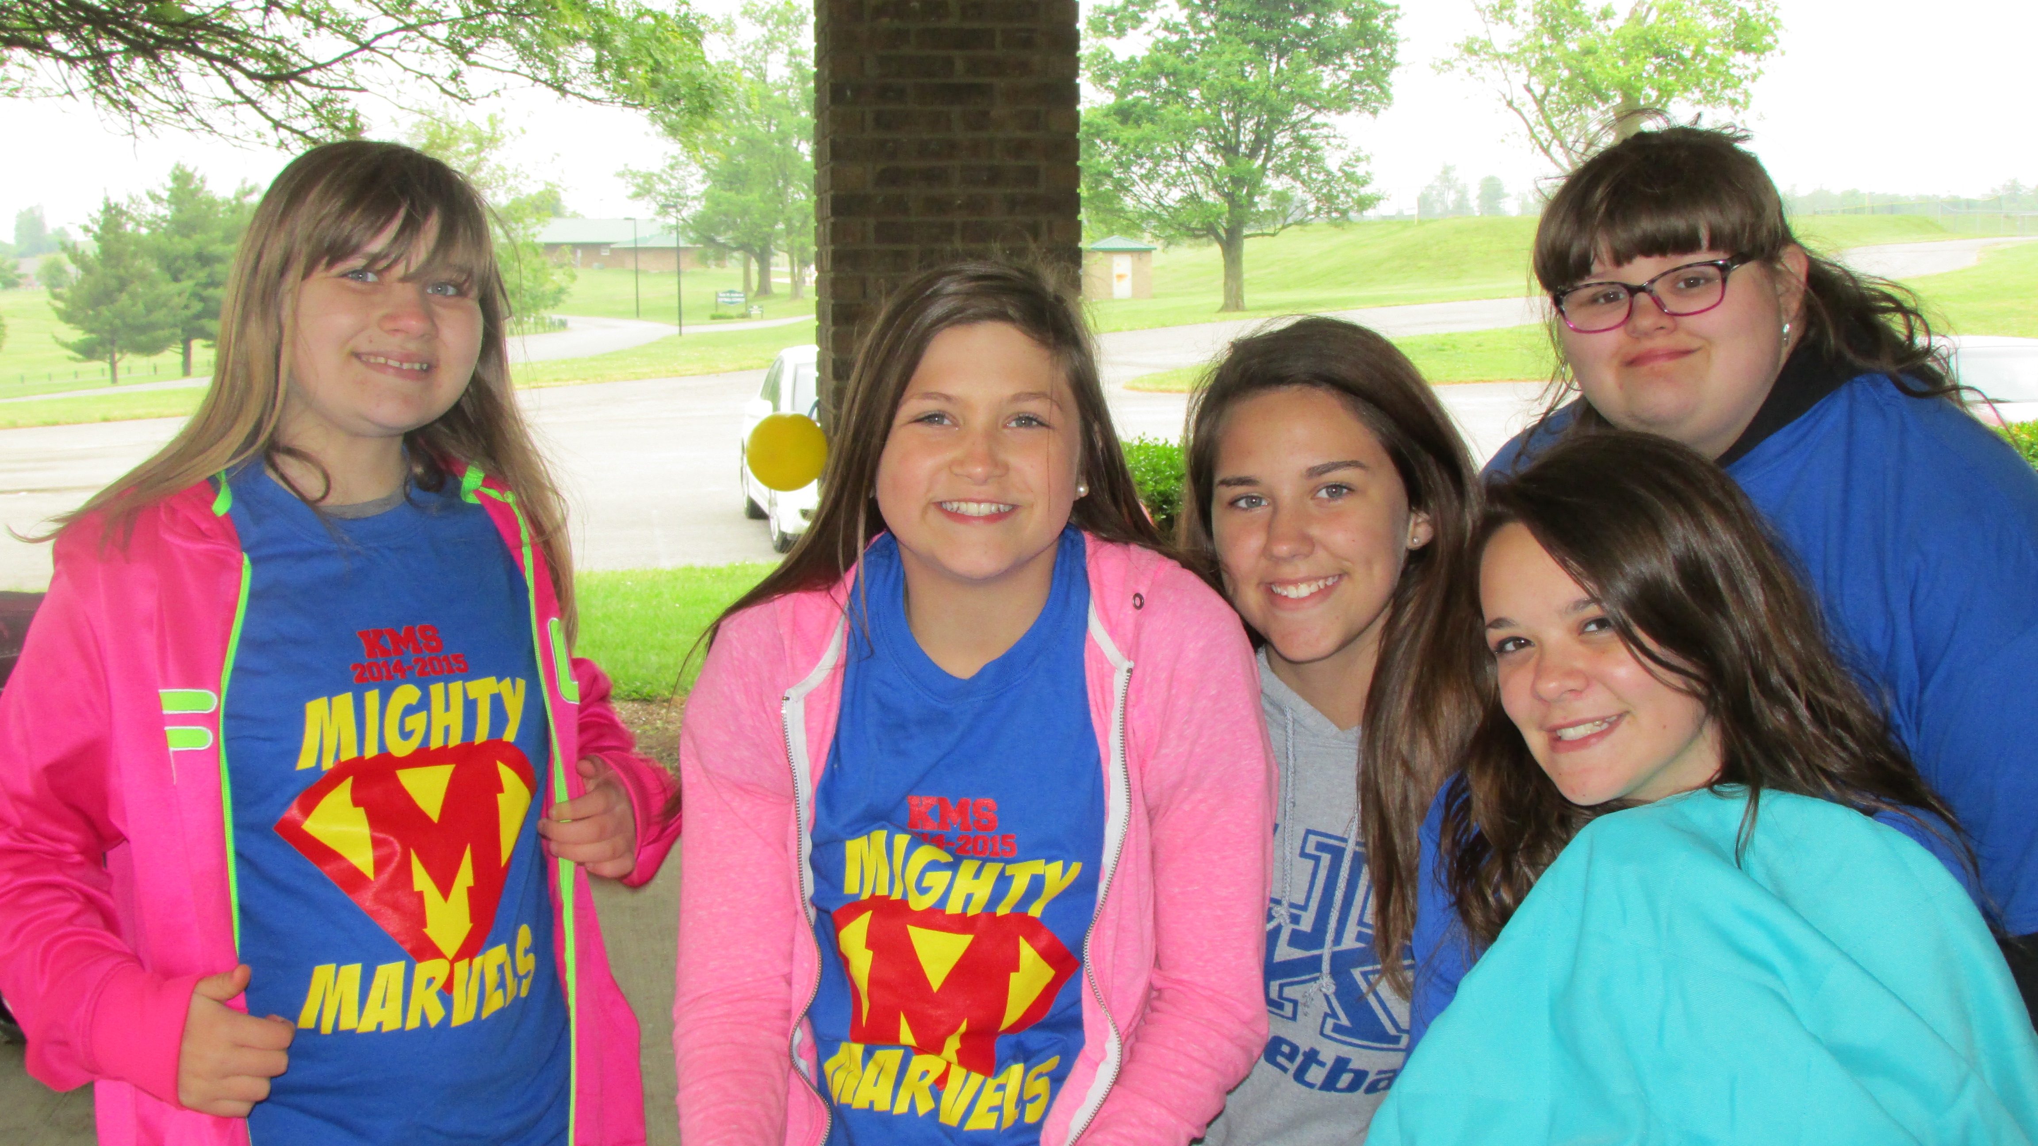
What is it like to be in a peer network?
Meet once a week for 30 minutes
during lunch
before or after school, or
during a free period in the school day.
Possible Activities
Games
Sports
Crafts
Some networks just like to eat lunch and talk. Network members can agree on what they want!

Slide 4
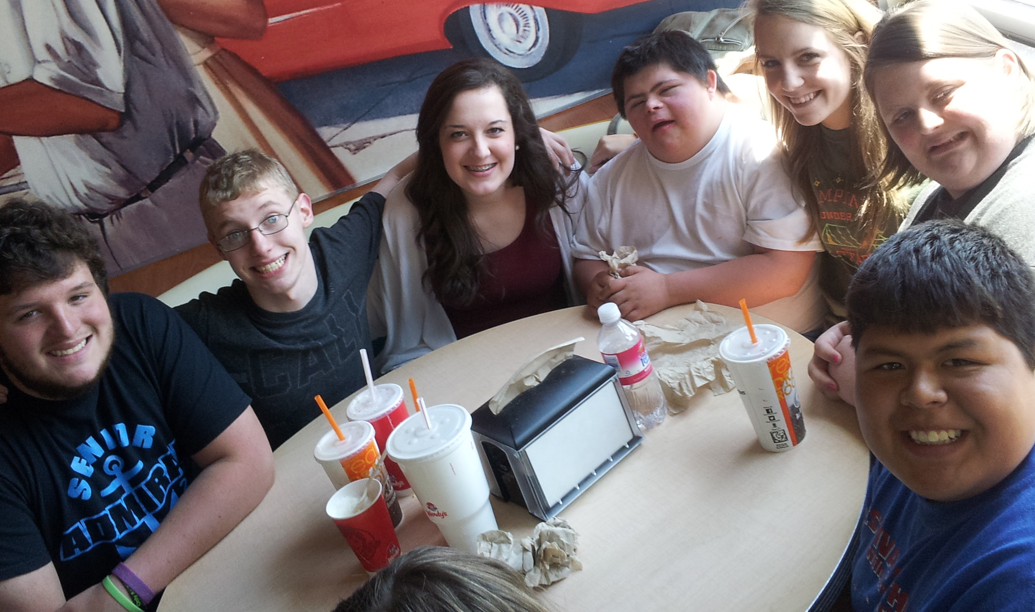
What is it like to be in a peer network? (continued)
Some networks like to plan activities outside the regular weekly meeting time. Some examples:
During the school day – hanging out between classes
After-school activities – going to a game or club meeting together
Community outing – going out for pizza or a movie
An adult “facilitator” will be there during network meetings, but this is YOUR network! Students take the lead!

Slide 5
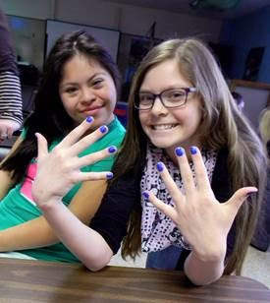
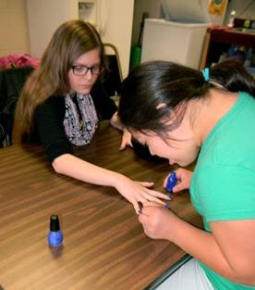
Why join a peer network?
Meet new people.
Help each other feel welcome and included.
Plan activities around common interests.
Connect with each other throughout the week.
Have fun!

Slide 6
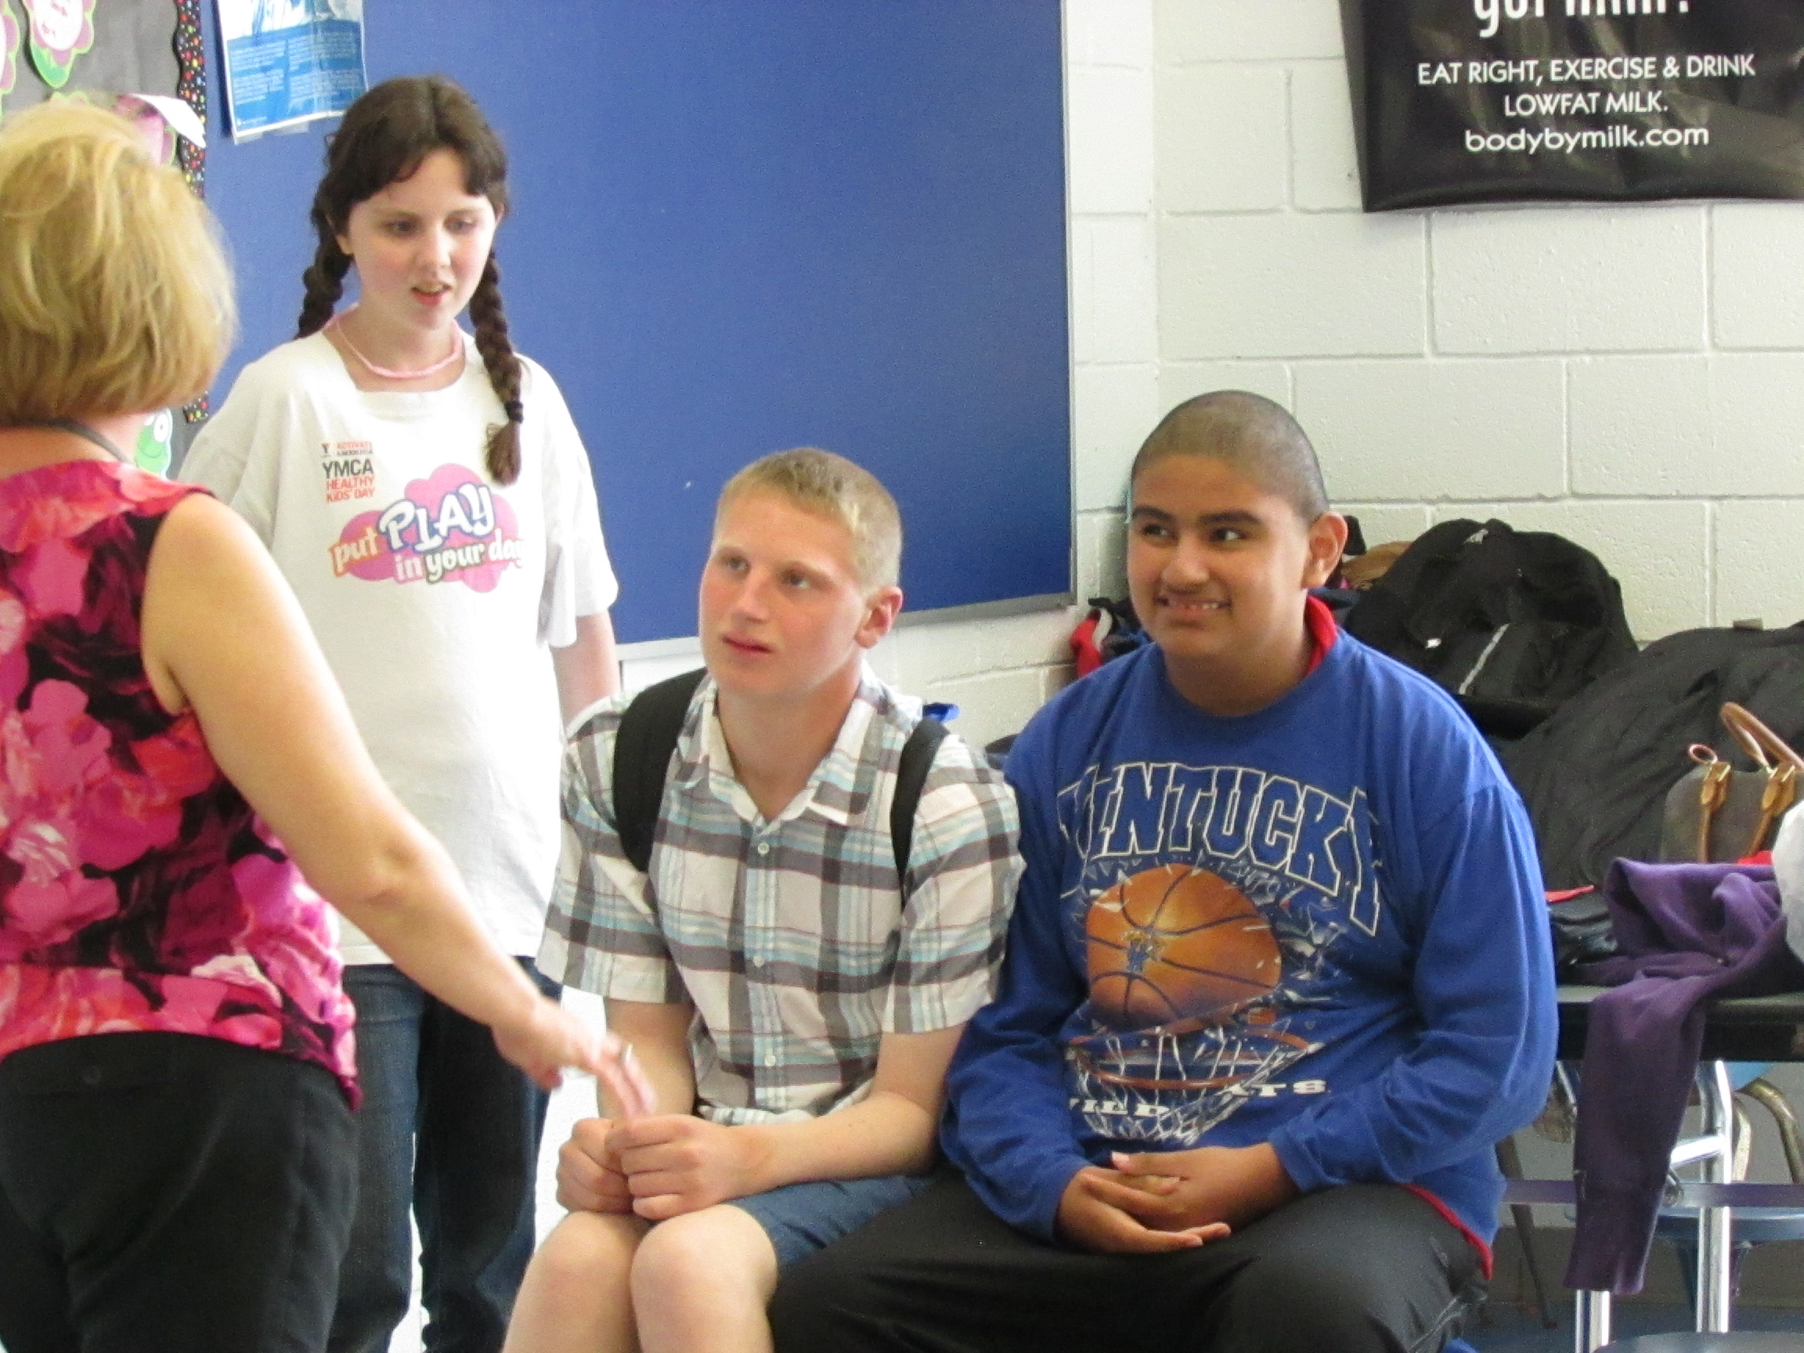
Peer Network Orientation
Introductions – ice breaker activity to introduce everyone, and talk about strengths and interests
Discuss goals of the group and role of the facilitator
Your network facilitator will talk to you about:
Confidentiality and respectful language
Ways to support each other
Any special communication needs of group members
Other expectations

Slide 7
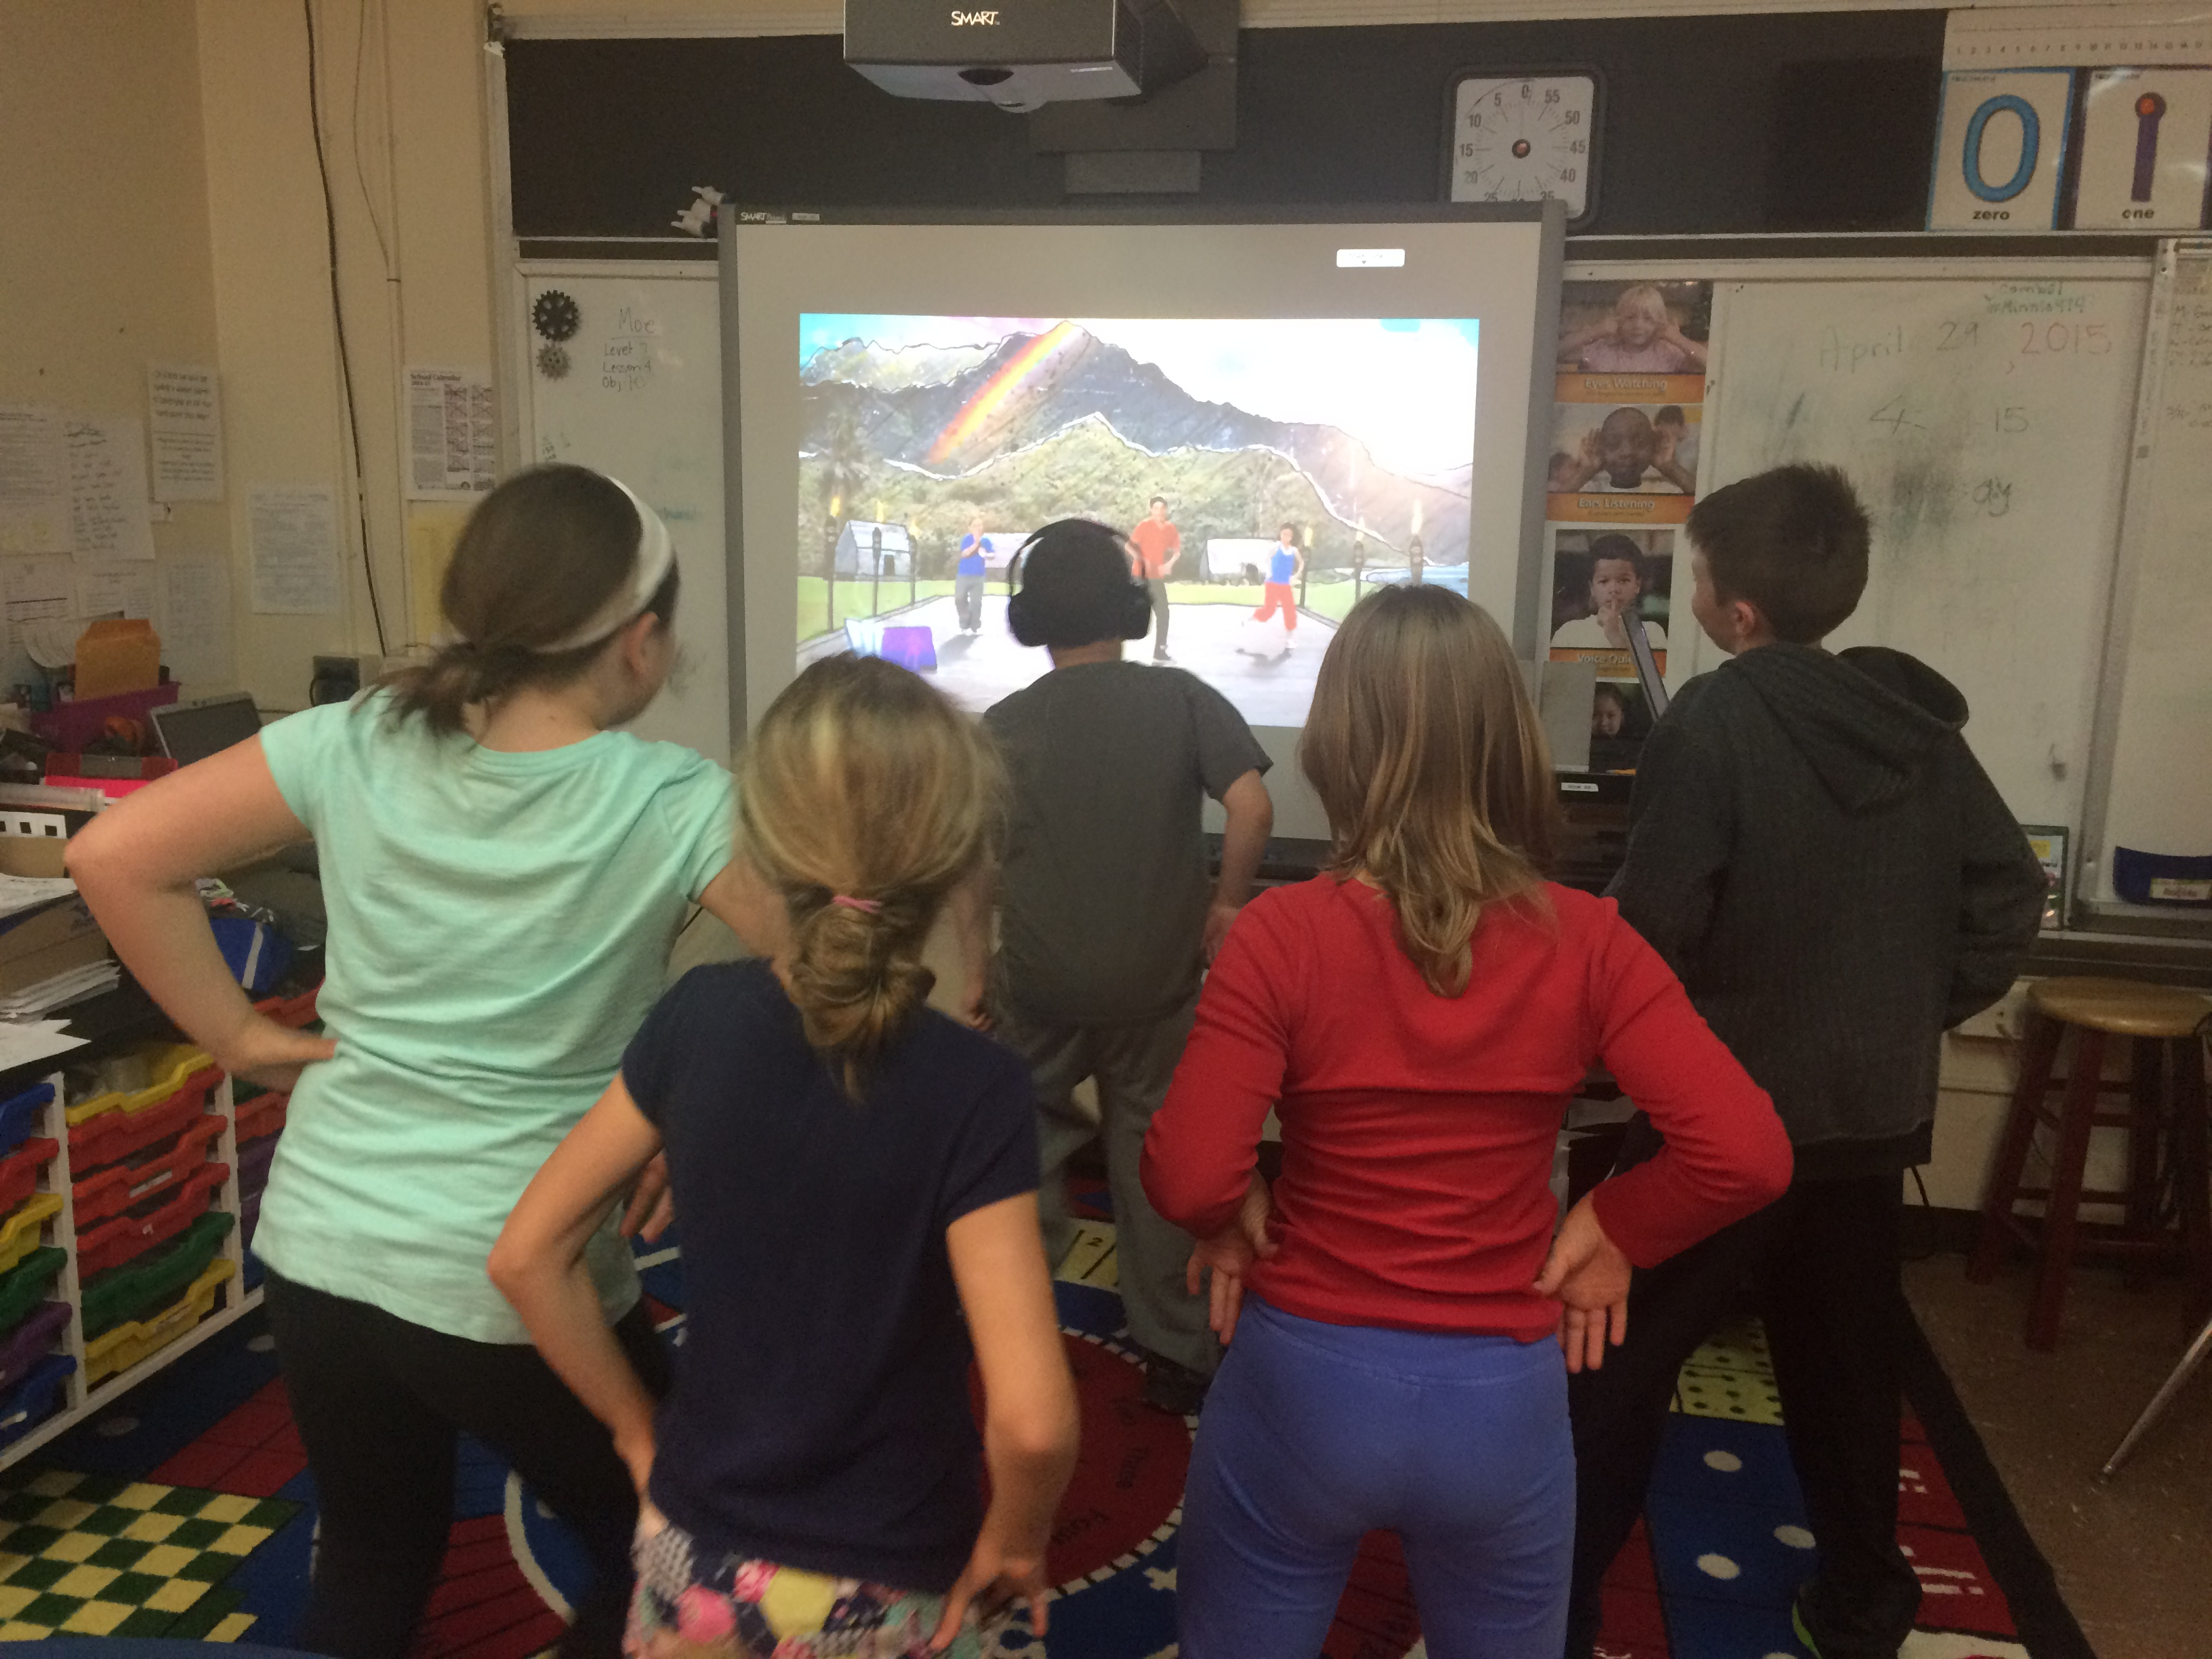
Peer Network Orientation (continued)
Schedule regular weekly meetings and plan possible network activities
Discuss social contacts outside the weekly meeting
Q & A

Slide 8
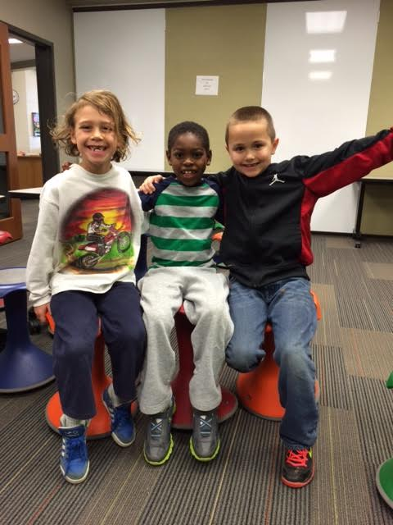
Reflection
What are your concerns and questions?
What are you excited about?
What ideas do you have for the group?

Slide 9
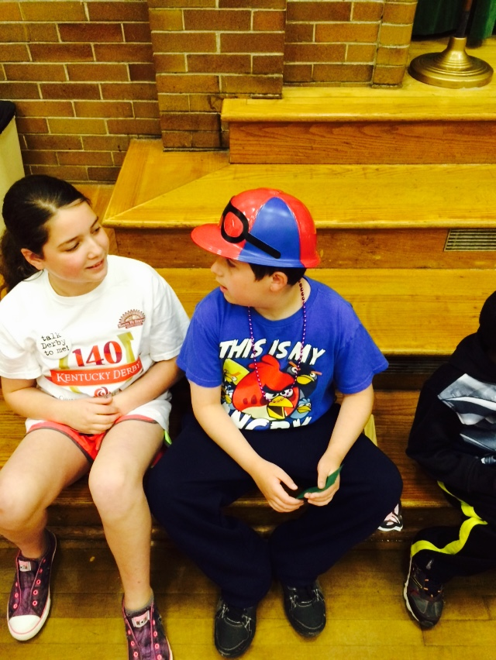
What is your Role as a Peer Partner?
Be kind!
Help others feel welcome and included
Introduce network members to your other friends
Help each other learn the “rules of the road”

Slide 10
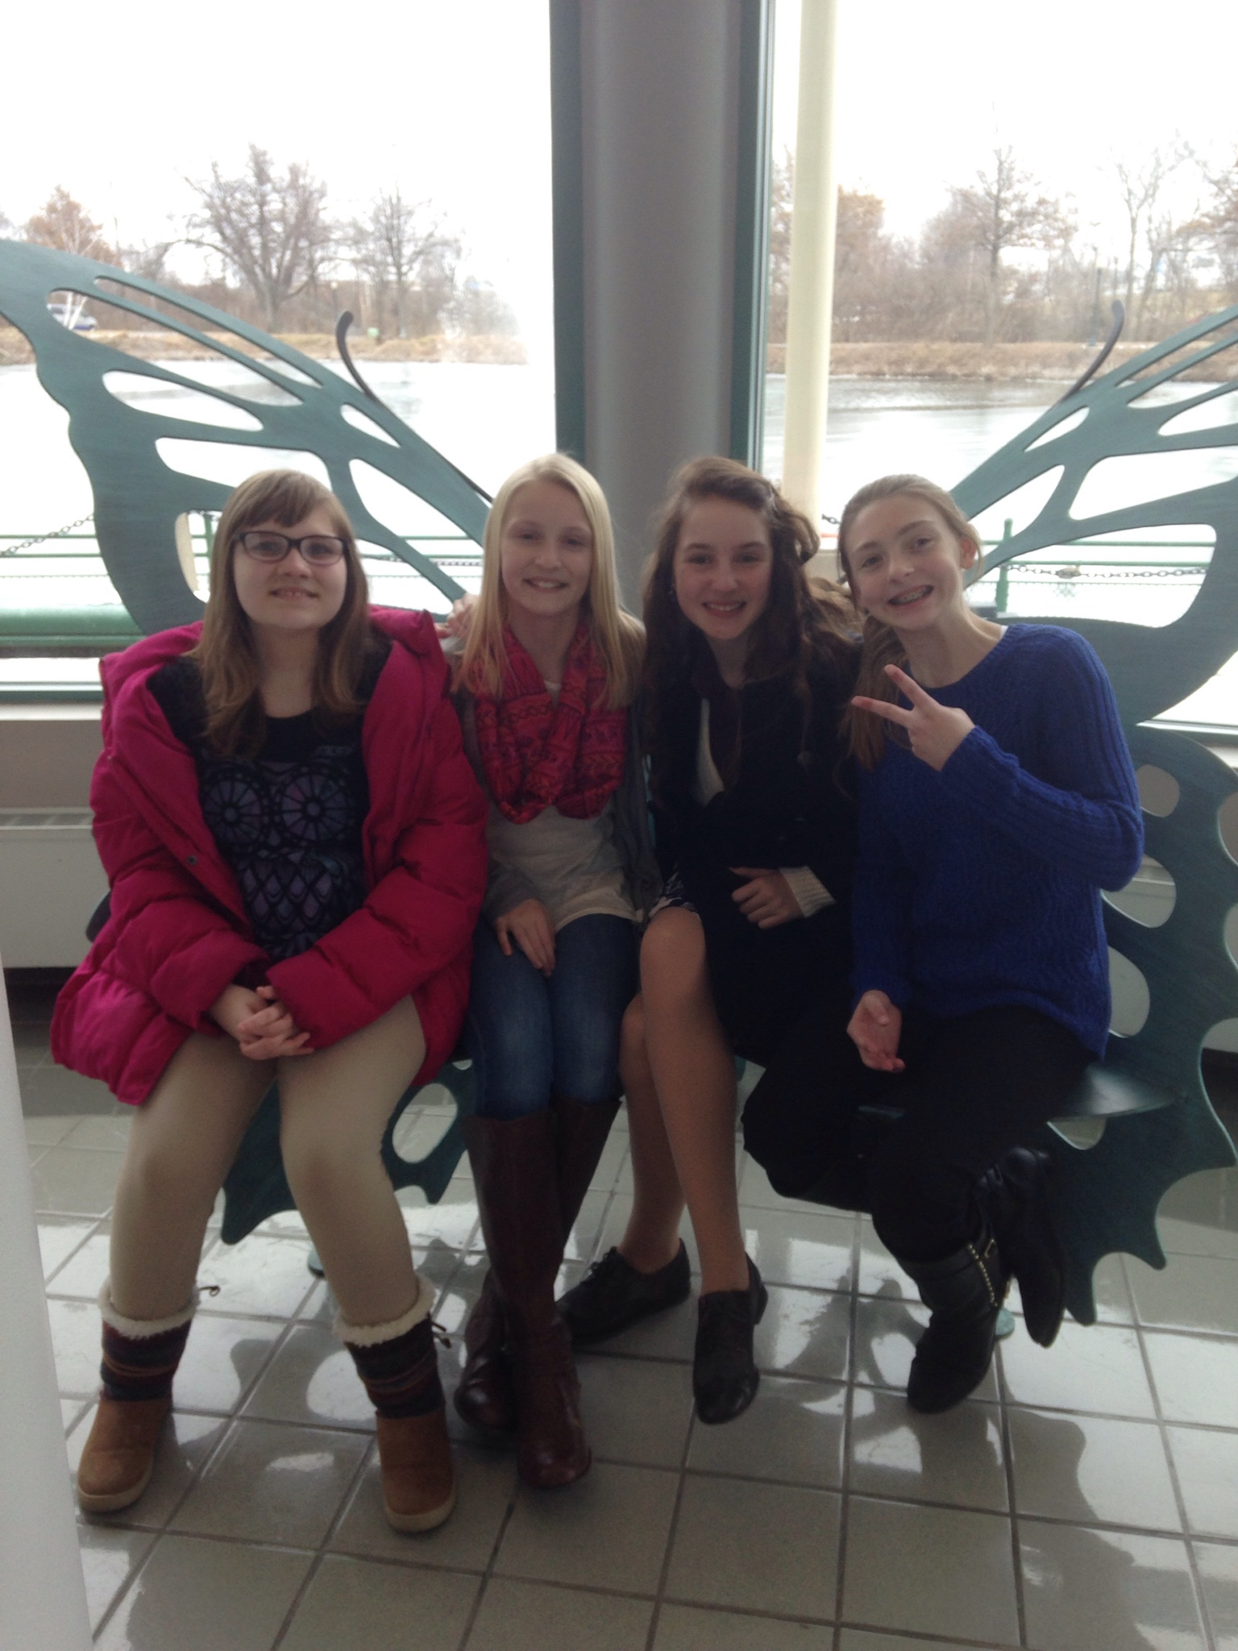
How can we help other people feel included?
Talk to each other!
Make plans for seeing each other between network meetings
Say hi between classes
Hang out together before or after school
Eat lunch together
Walk to class together
If possible, attend after school and/or community events together.
Other ideas?

Slide 11
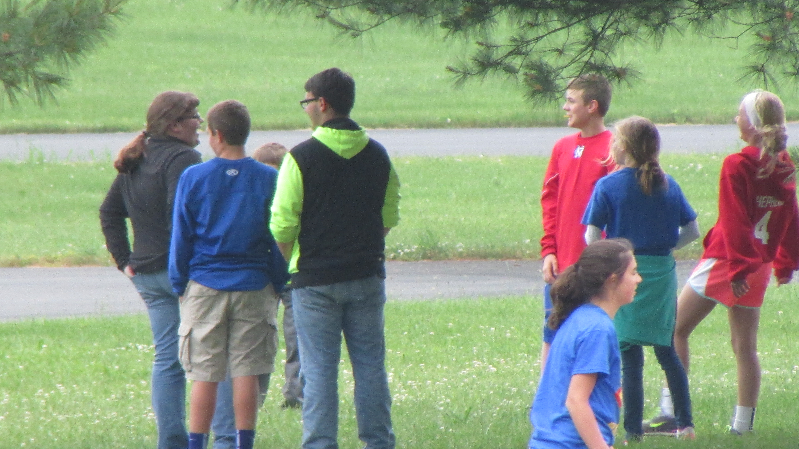
What’s special about our school?
Beyond school work and academics, what stands out about our school?
What are the social customs or “rules of the road” at our school?
How are YOU involved in the life of our school?
How can we help other students…
Learn about the social customs?
Be more involved in the everyday life of our school?
Have a sense of belonging?

Slide 12
Any Questions?

