Slide 1
Peer Support in the Classroom
What does it mean to be part of a Community of Learners?

Slide 2
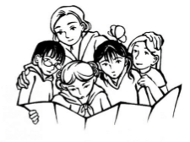
What is a Community of Learners?
A group of people who actively help each other learn. For example, a class or even a small group of students who study together can be their own community of learners!
A Learning Community:
Supports all of its members to learn.
Make sure everyone can participate.
Makes sure that everyone feels they belong – that they have a part to contribute to the whole group!
Source: http://learningandtheadolescentmind.org/ideas_community.html
Notes:
From: http://learningandtheadolescentmind.org/ideas_community.html

Slide 3
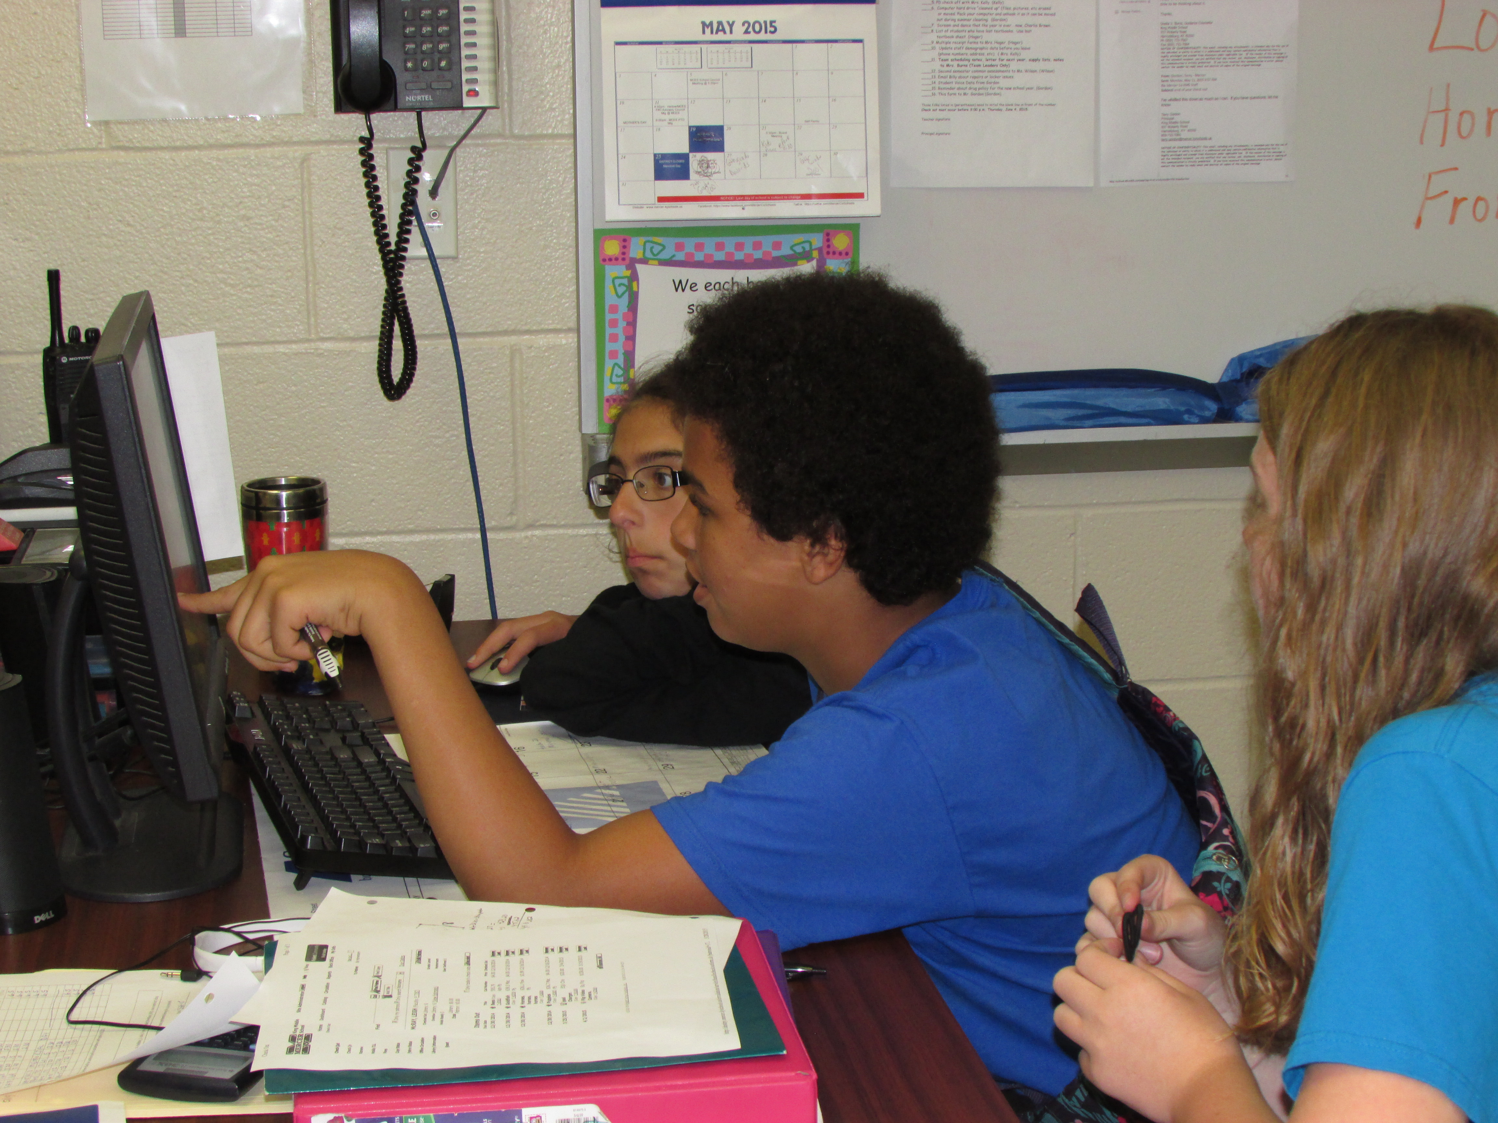
How do we help each other learn?
Support each other in class activities
Encourage each other
Model good habits and behavior
Help each other understand directions
Discuss assignments during worktime
What else?

Slide 4
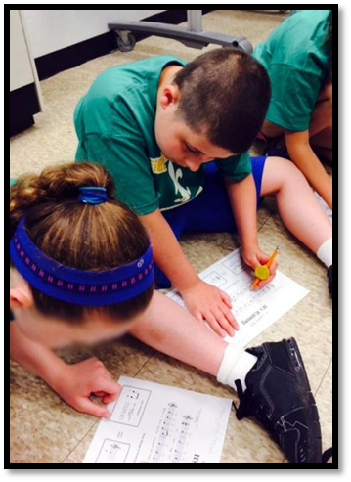
Discuss
What are some ways you and your classmates support each other?
What are some other supports that might help you learn?

Slide 5
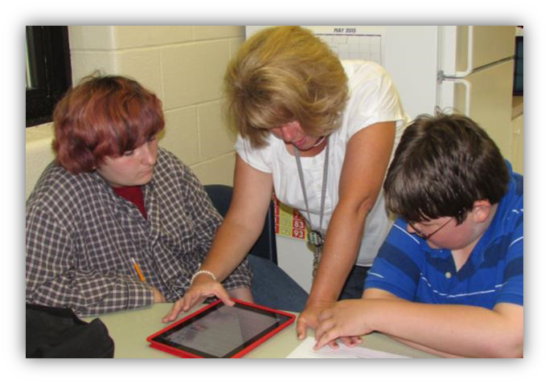
Peer Support Arrangements
Within your classroom, your teacher may invite you to sit in a group of two to four peers to support each other’s learning.

Slide 6
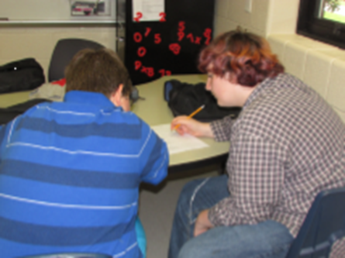
What does Peer Support look like?
Helping each other keep assignments and class materials organized
Reminding each other to follow classroom rules and stay on task
Sharing notes or assisting with completing guided notes
Paraphrasing lectures or rephrasing key ideas
Demonstrating how to complete a problem

Slide 7
What does Peer Support look like? (cont’d)
Encouraging interactions with other classmates
Prompting to answer a question or contribute an idea
Checking the accuracy of assignments and class work together
Writing down answers given orally or using a communication device
Walking together from one class to the next

Slide 8
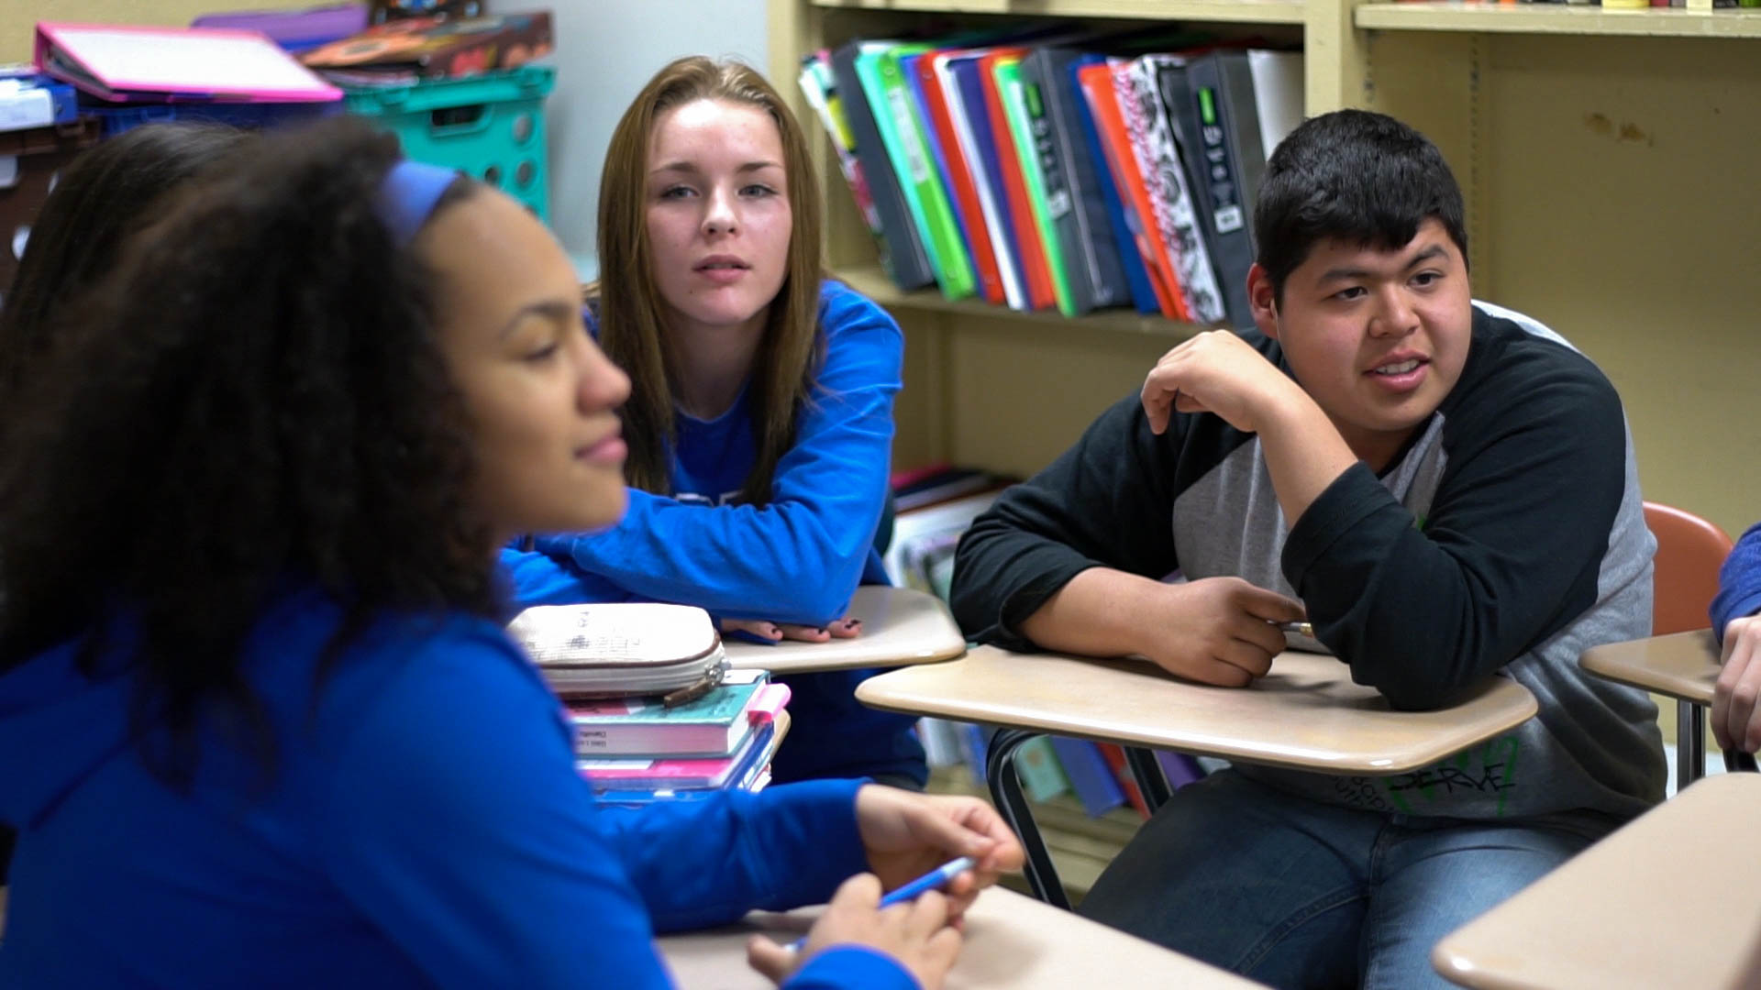
Why do this?
Get to know other classmates better
Help your classmates learn
Increase your own learning
Research has shown that students in Peer Support Arrangements make the same or better grades
Have fun!

